Slide 1

Robinhood Mobile Application Review
October 2019 | San Jose State University
Team Phoenix
Contributors-
Venkata Esha Prajwal Kondubhatla
Sita Anusha Poosarla
Shubham Sand
Hema Mutyala

Slide 2
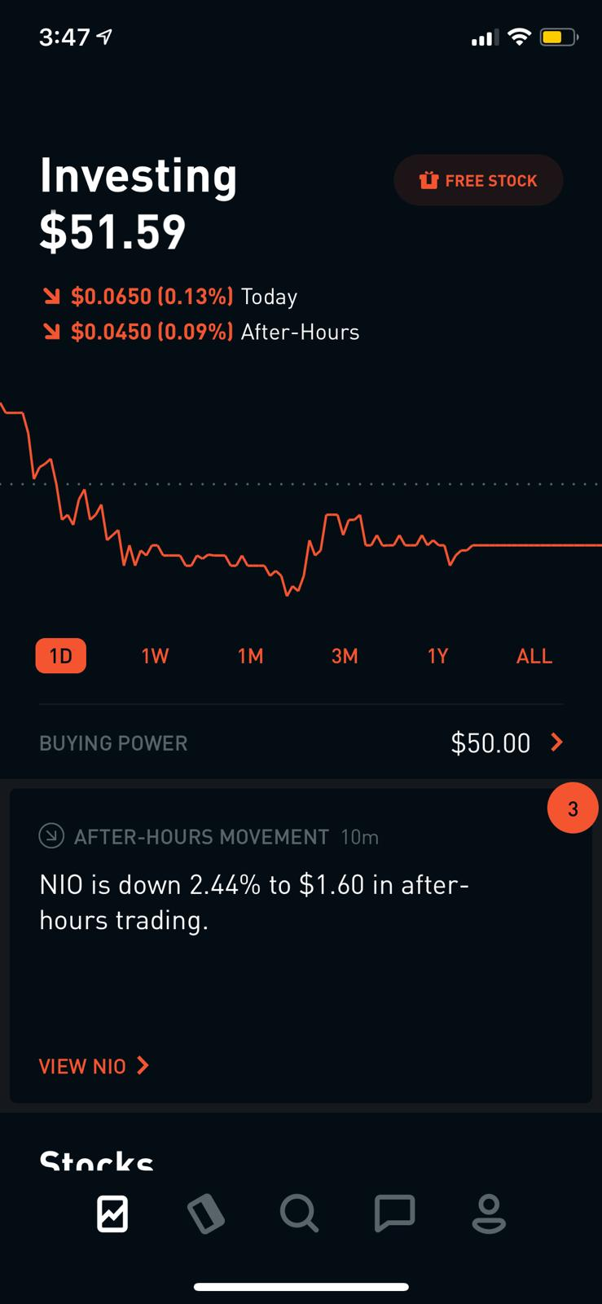
Introduction
Robinhood - U.S based financial service company.
Smartphone mobile app.
There are five features - Investing and stock information page, cash management, search, messages, and settings.

Slide 3
Robinhood - Product Overview
Investing Capacity
Price variation in a day
Timeframe
Search
Cash Management
Messages
Stock Information
Account settings

Slide 4
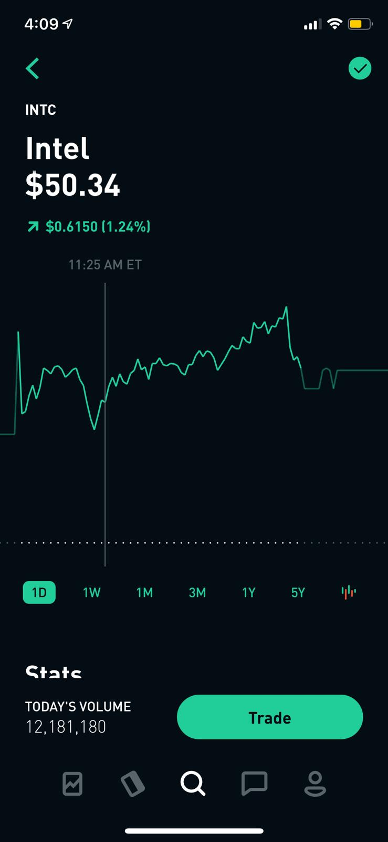
Features Evaluated
The features evaluated for the app are:
Stock information and search
Buy/Sell Options
Account Settings
1
2
3

Slide 5
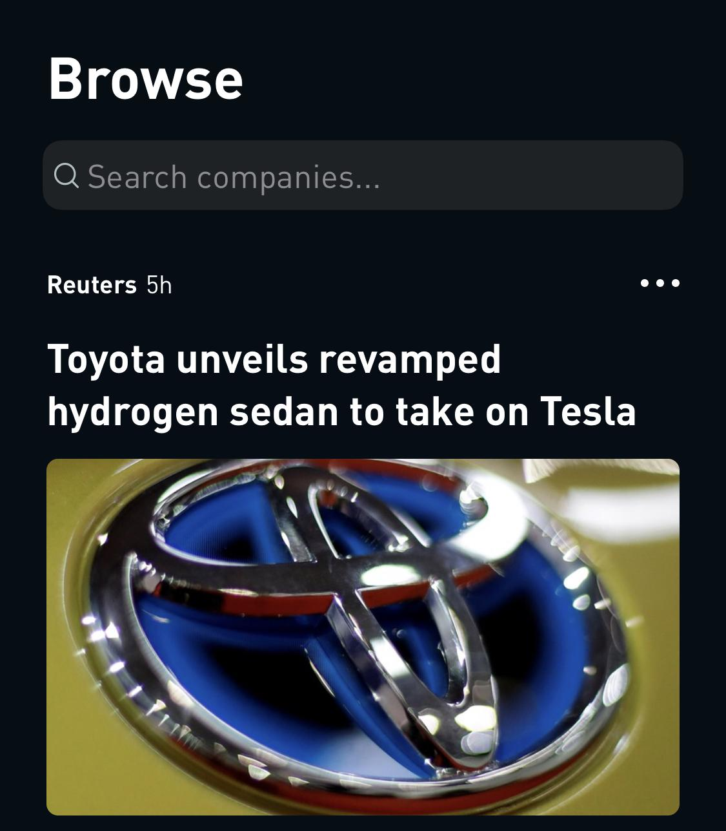
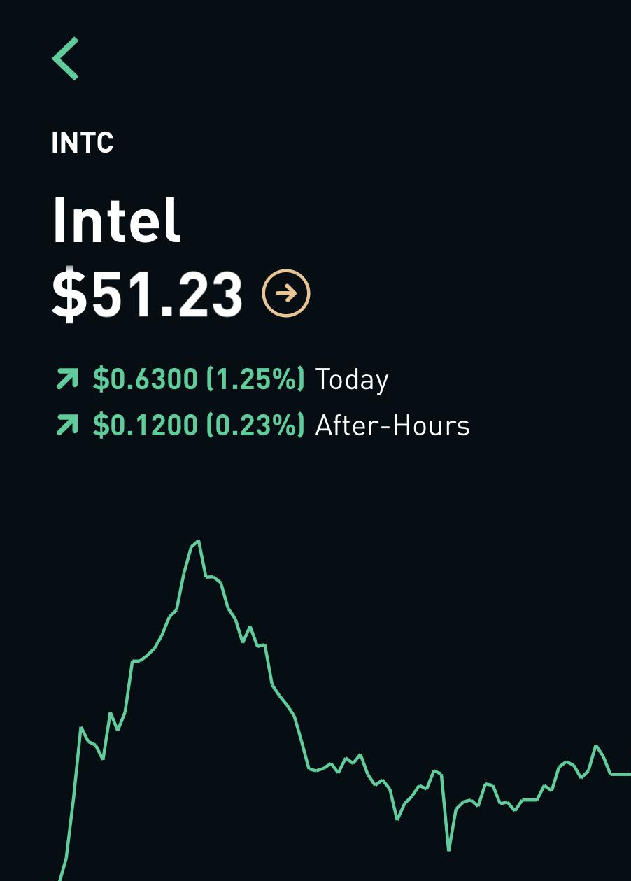
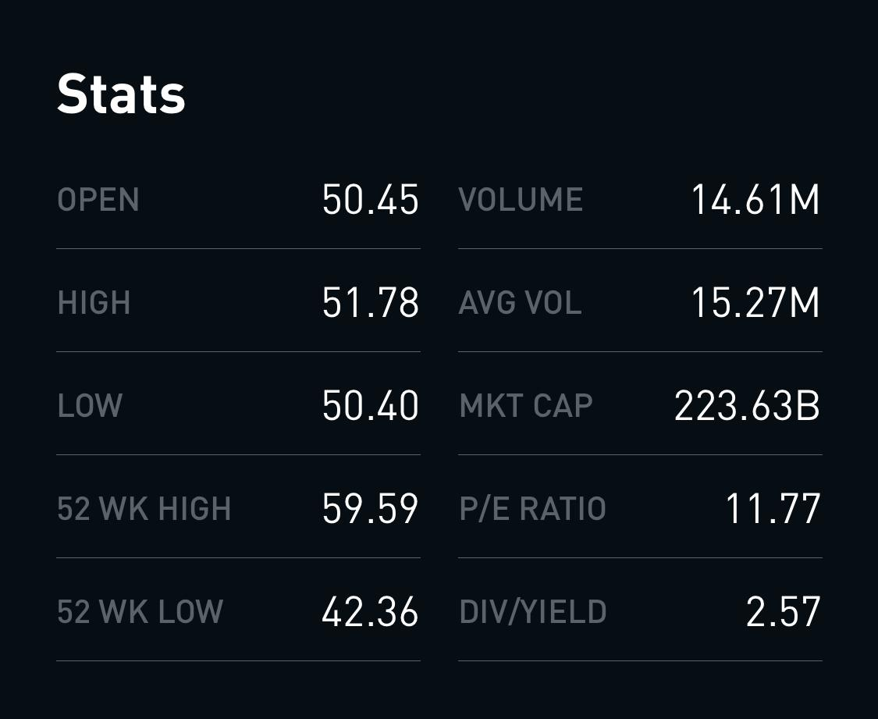
Stock information and search
Stock information page shows detailed performance of a particular stock.
The Good:
Mapping
Visibility
Grouping
The Bad:
Feedback
Limit Cognitive load complexity

Slide 6
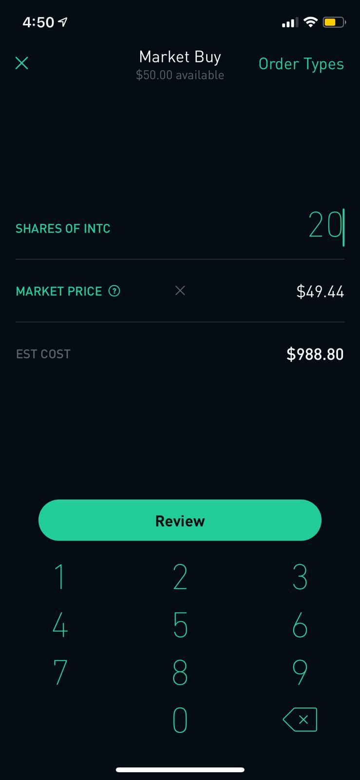
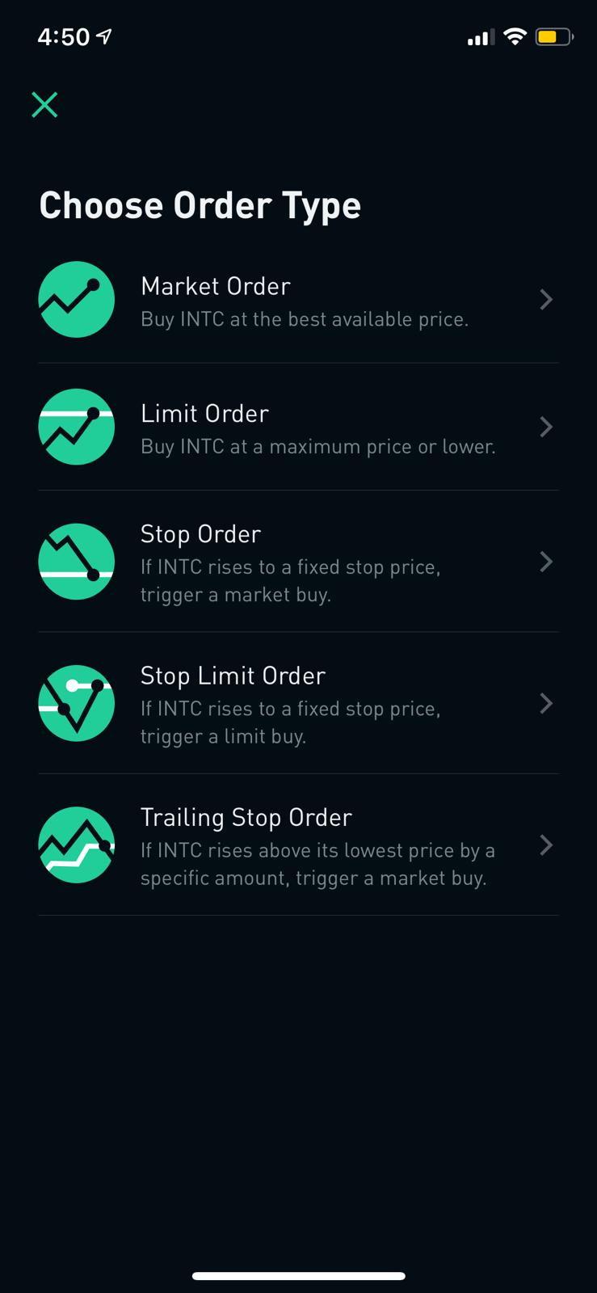
Buy/Sell Options
The Good:
Affordances
Mapping
Visibility
The Bad:
Mapping
Visibility

Slide 7
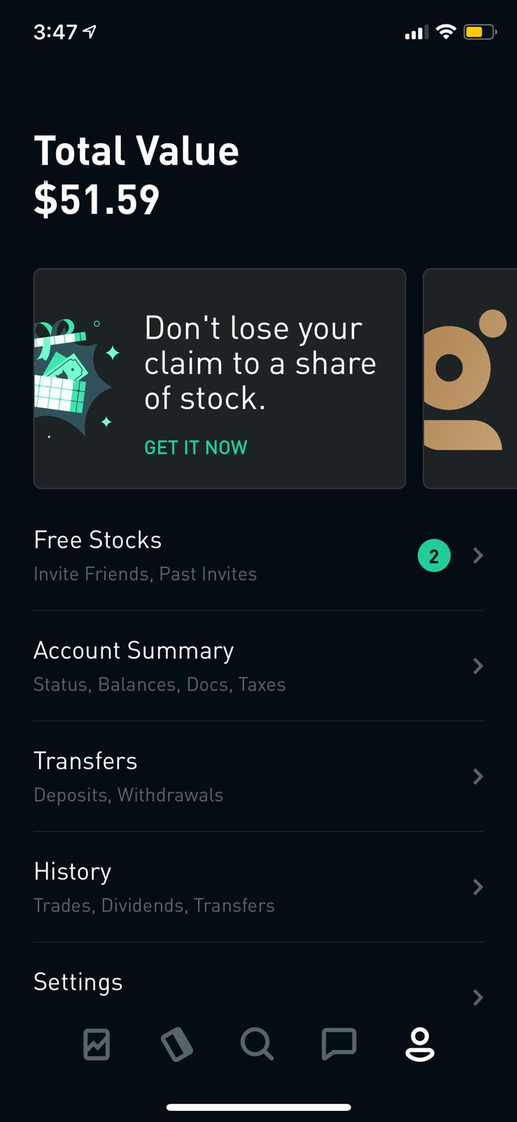
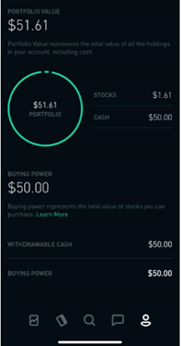
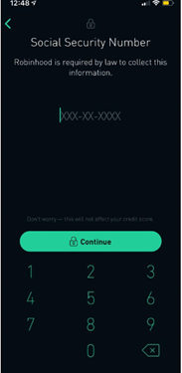
Account settings
The Good:
Grouping
Consistency and
Flexibility
The Bad:
Duplication
Limit cognitive load
and complexity
Flexibility

Slide 8



Comparative Study
The three apps we used to compare are
Robinhood
Fidelity
Ameritrade

Slide 9
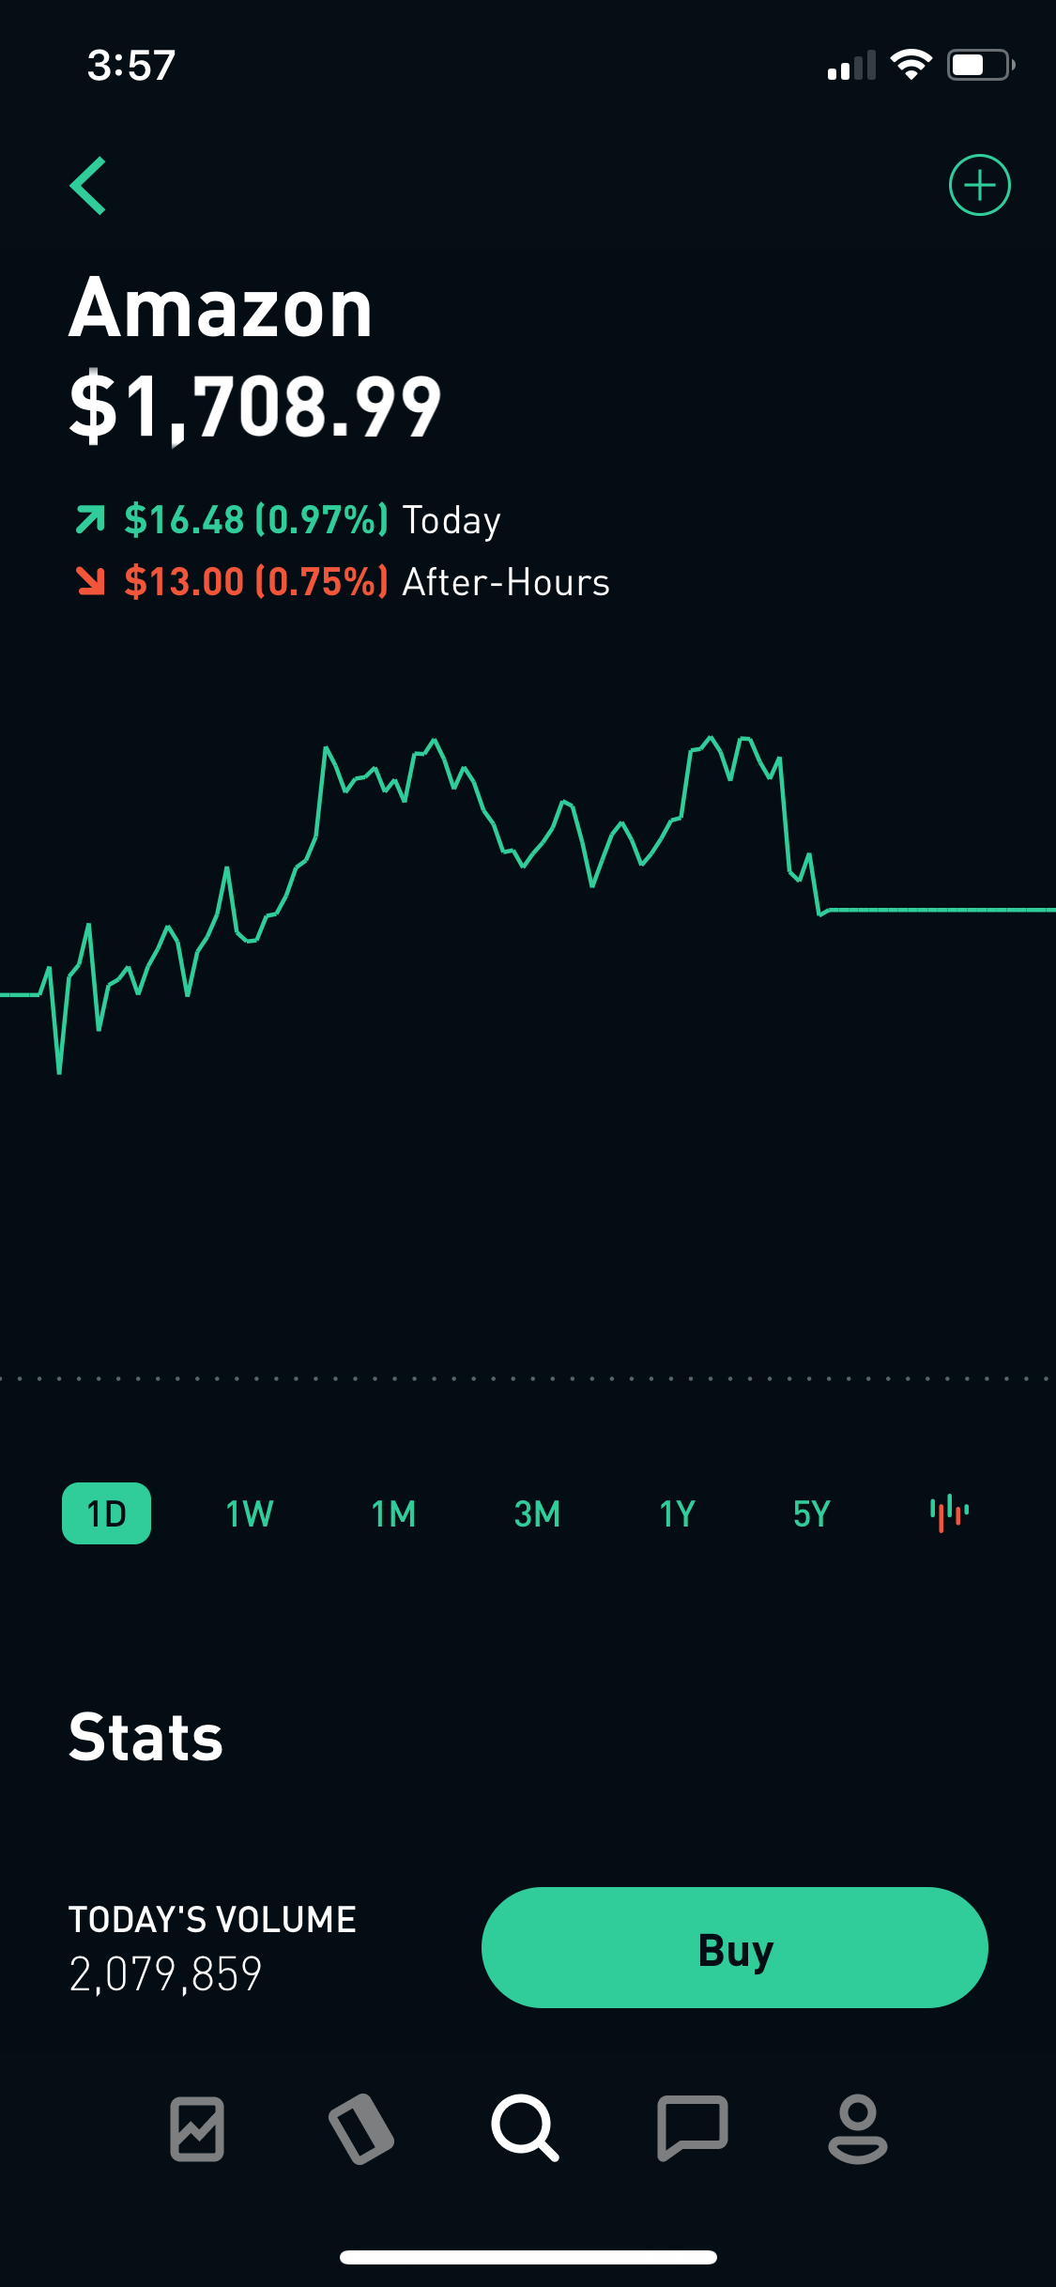
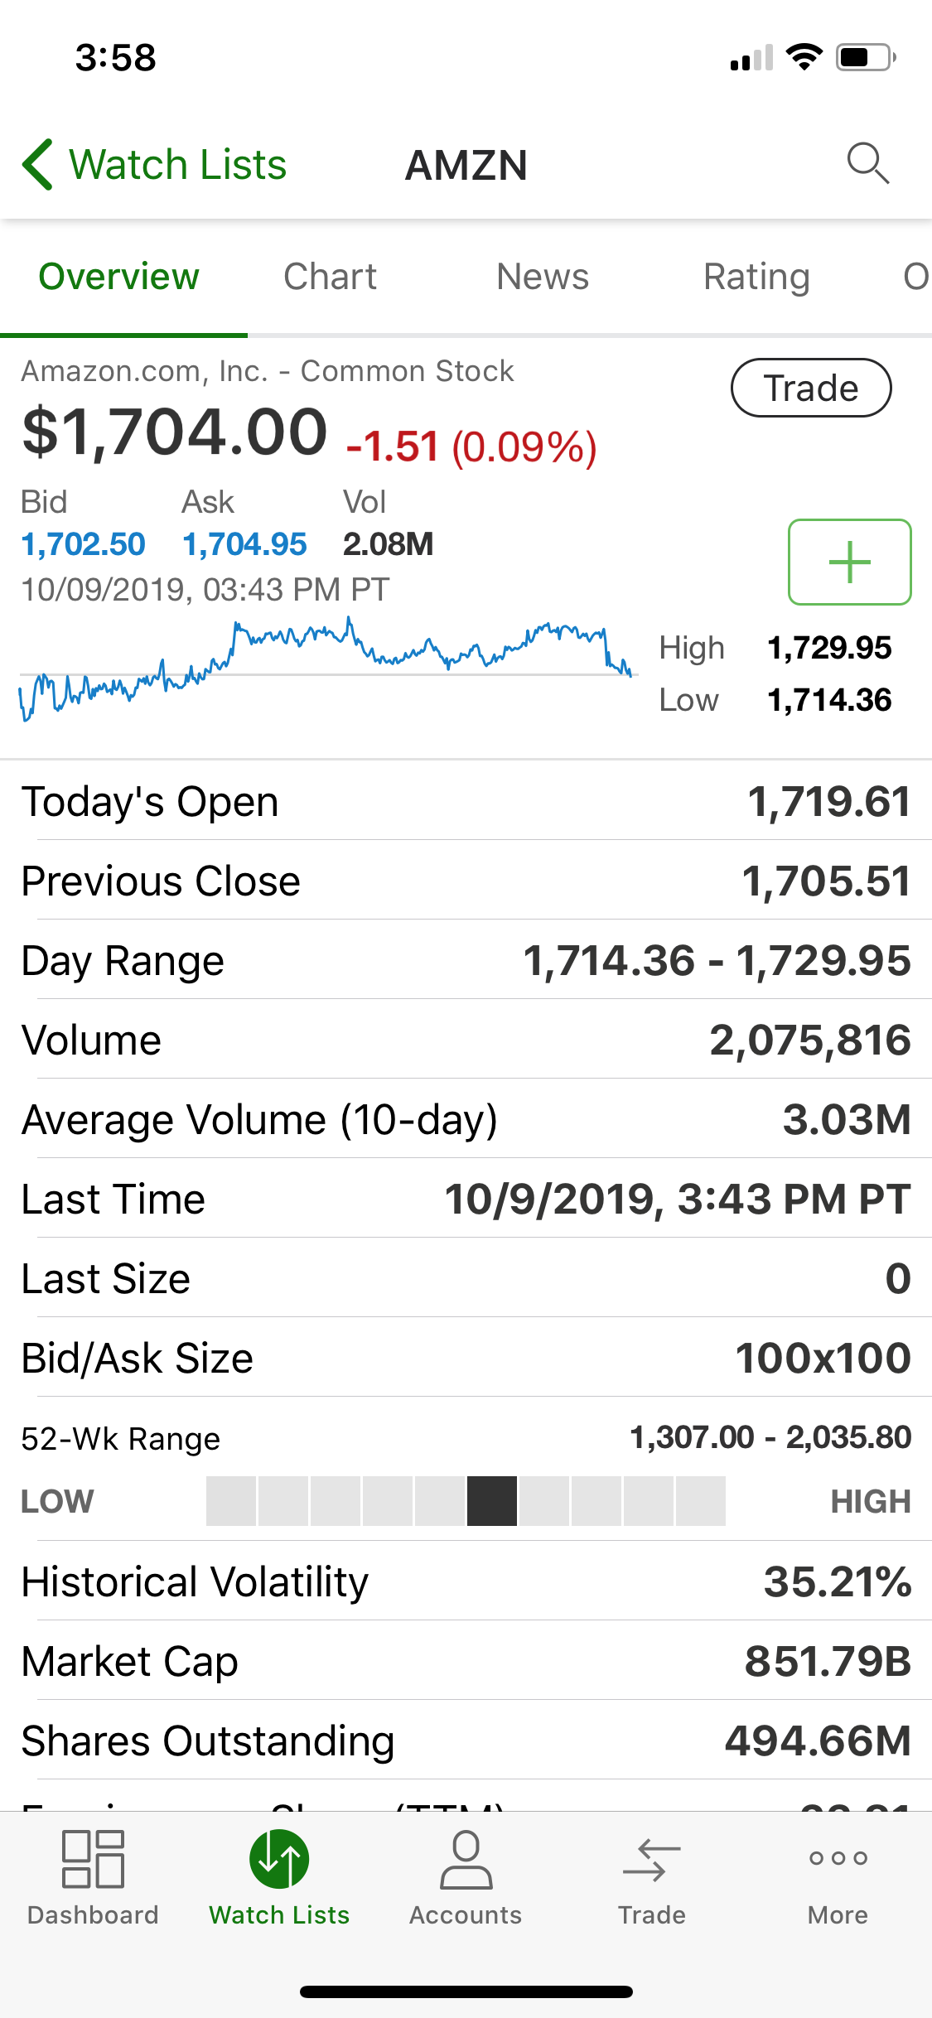
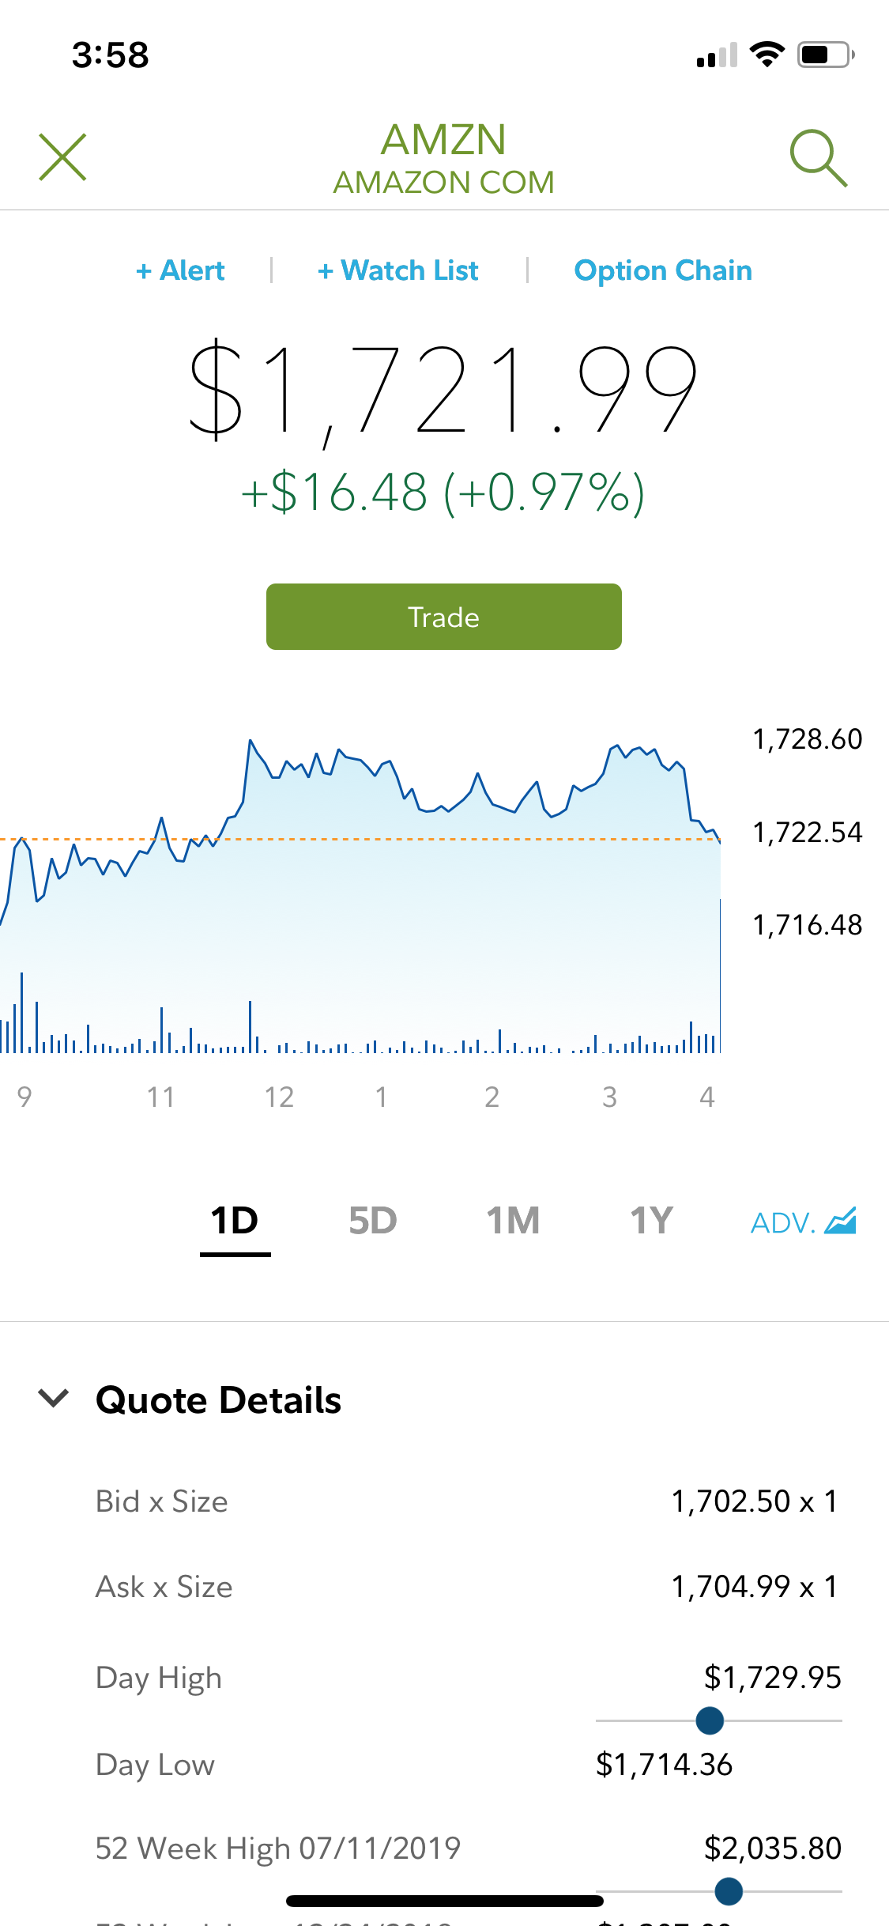
User Interface Elements
The following pages are compared in regards to UI elements
Stock price page
News page
Watchlist page

Slide 10
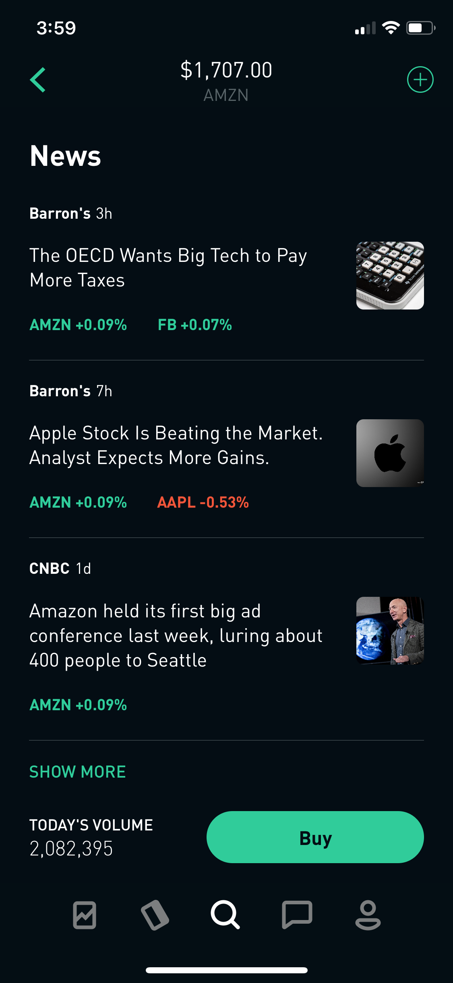
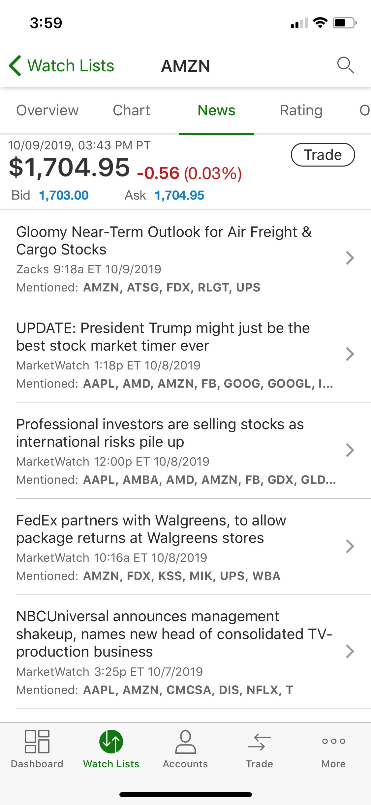
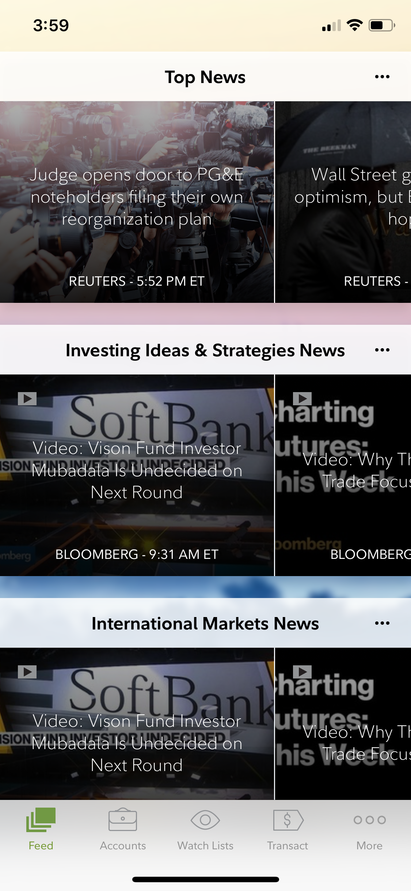
News page

Slide 11
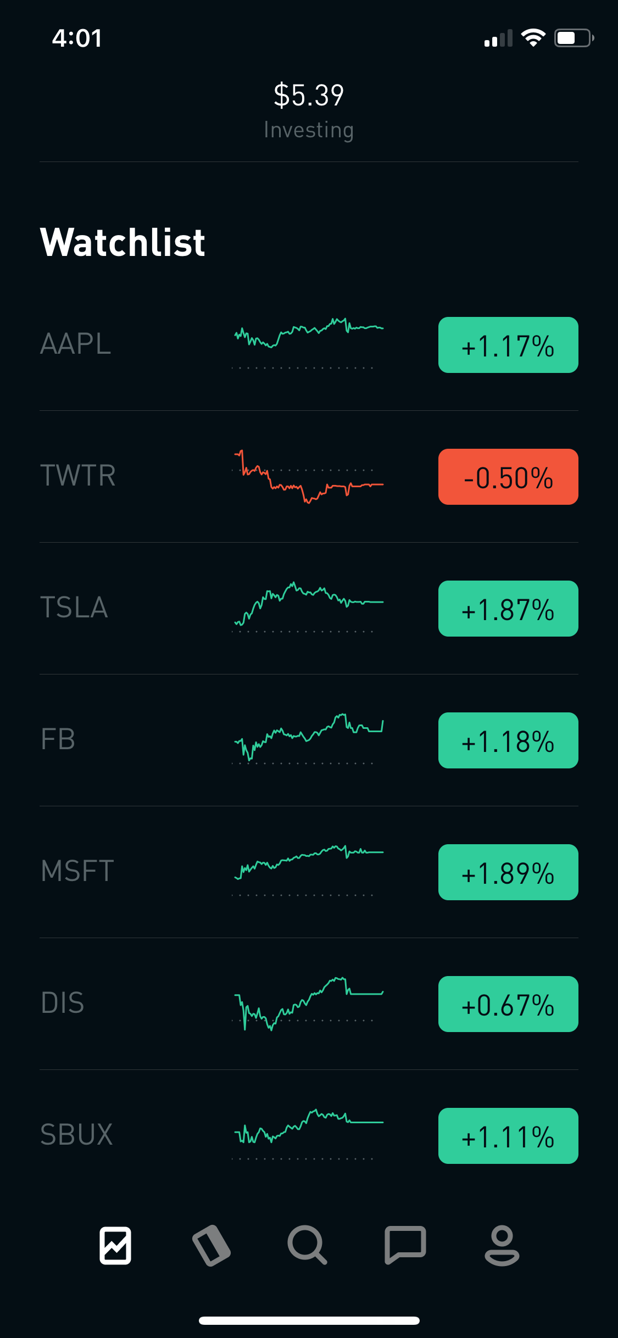
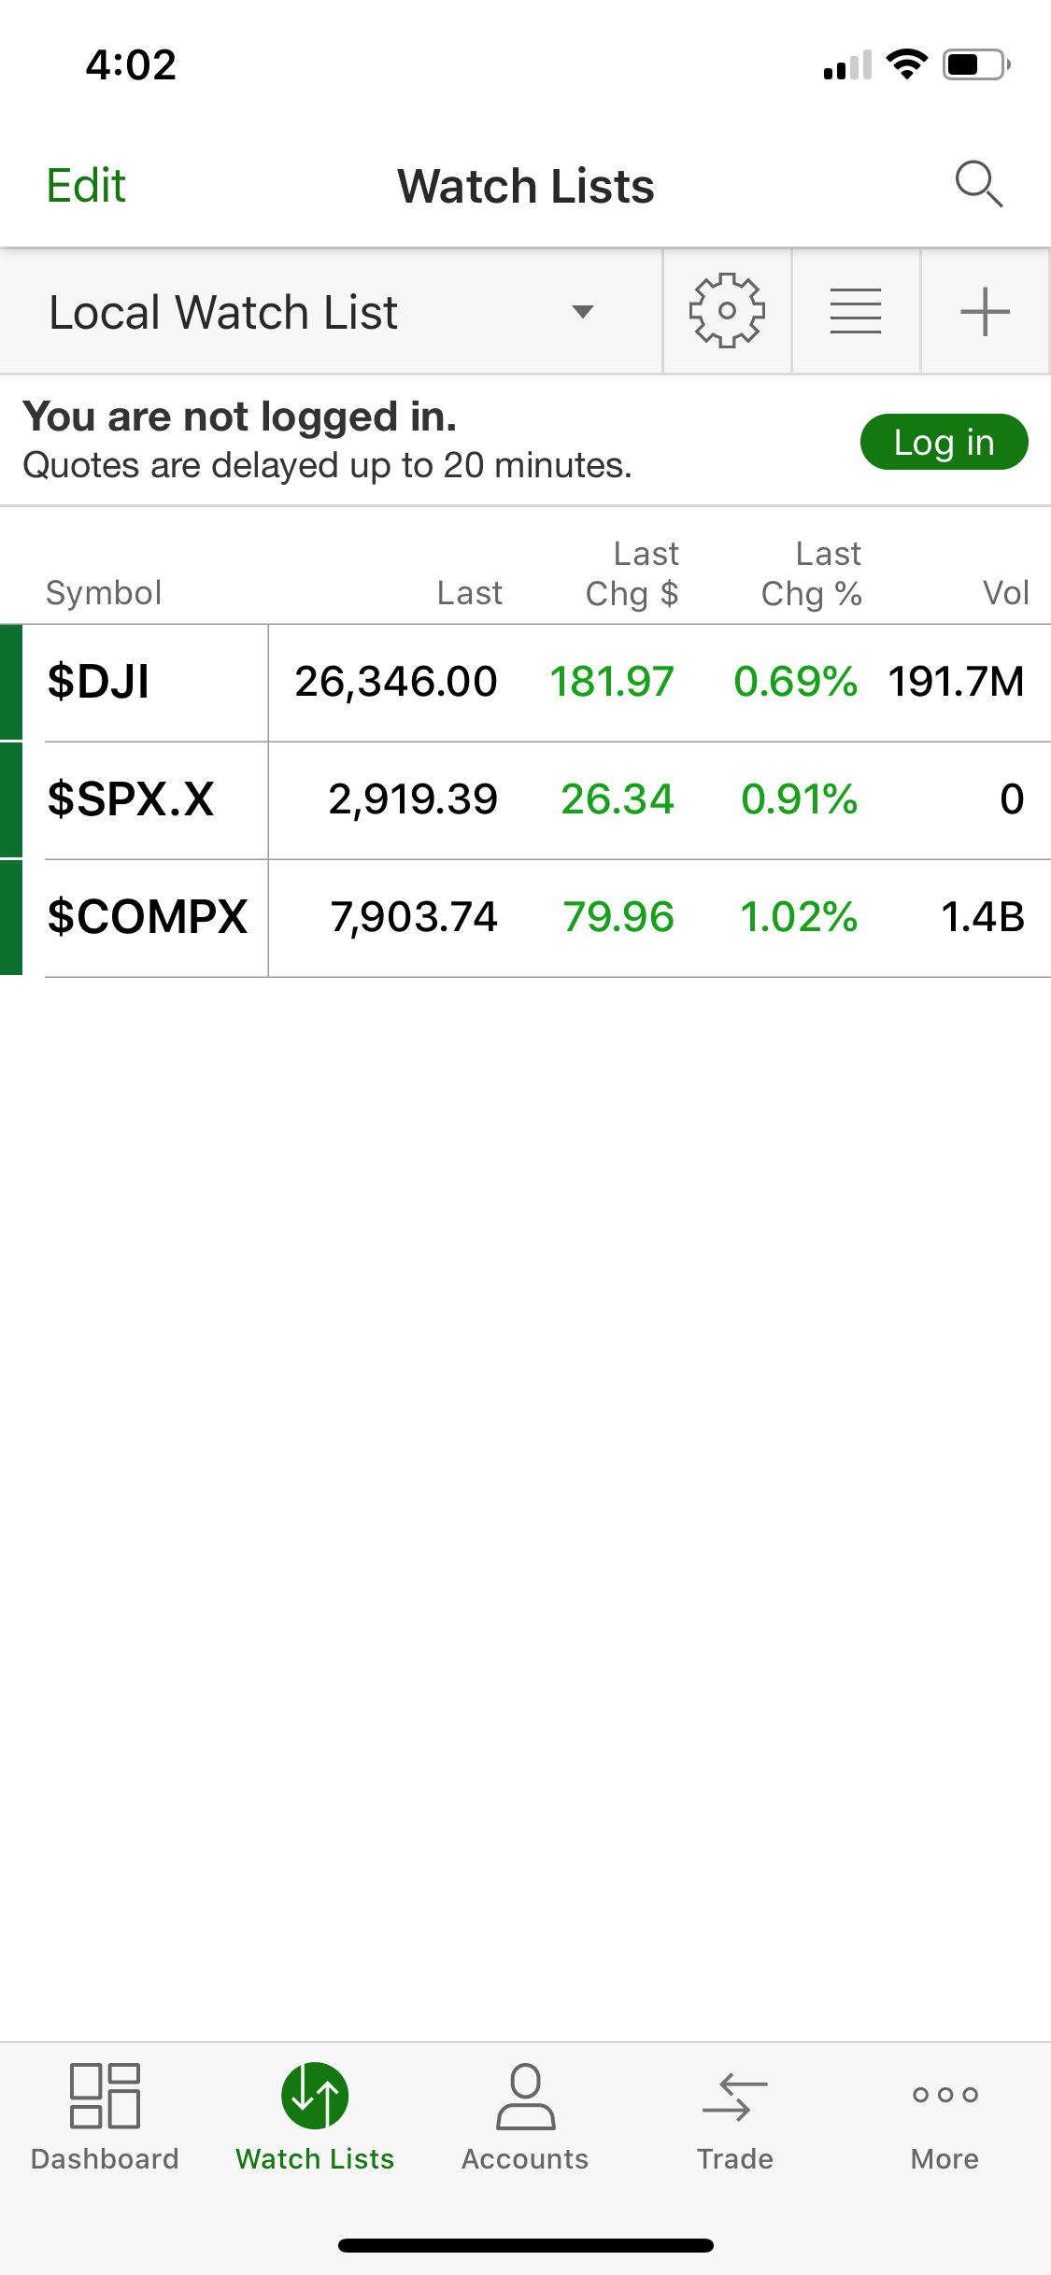
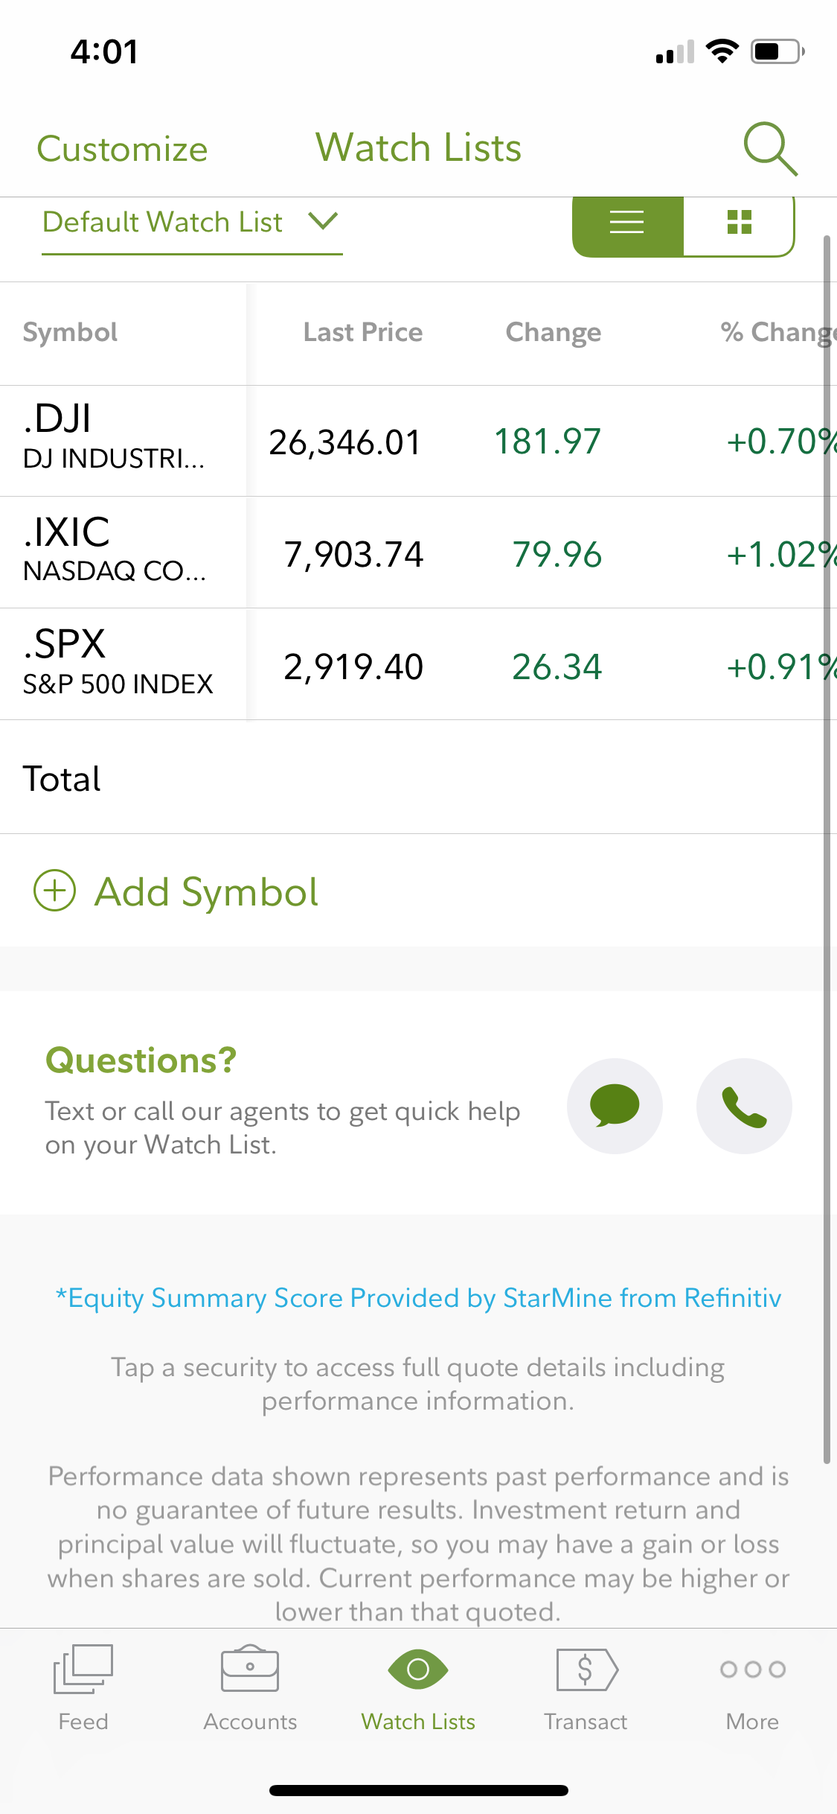
Watchlist page

Slide 12
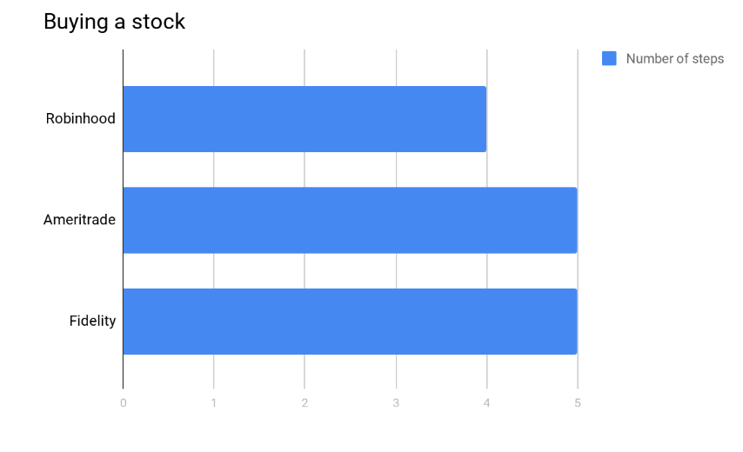
Task Flows
The following task flows are compared for the number of steps taken to finish the task
Buying a stock.
Adding a stock to the watchlist.
Reading company related news.

Slide 13
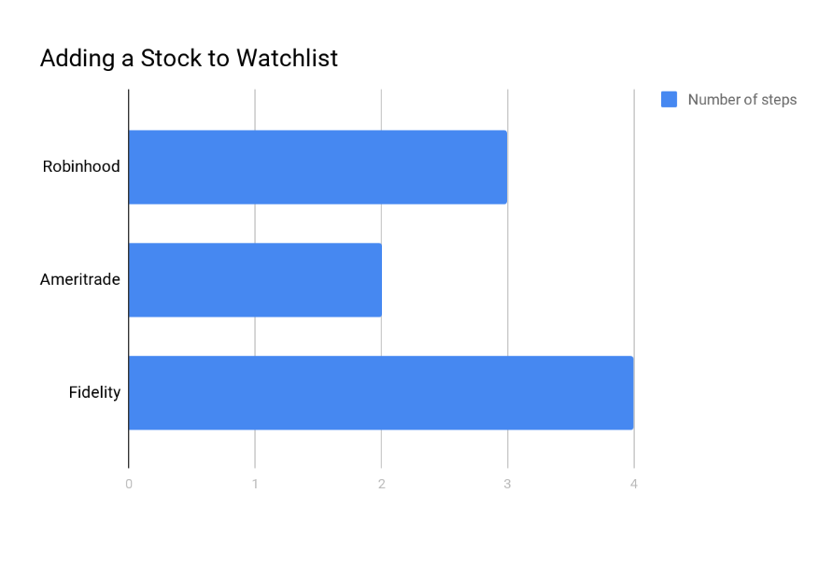
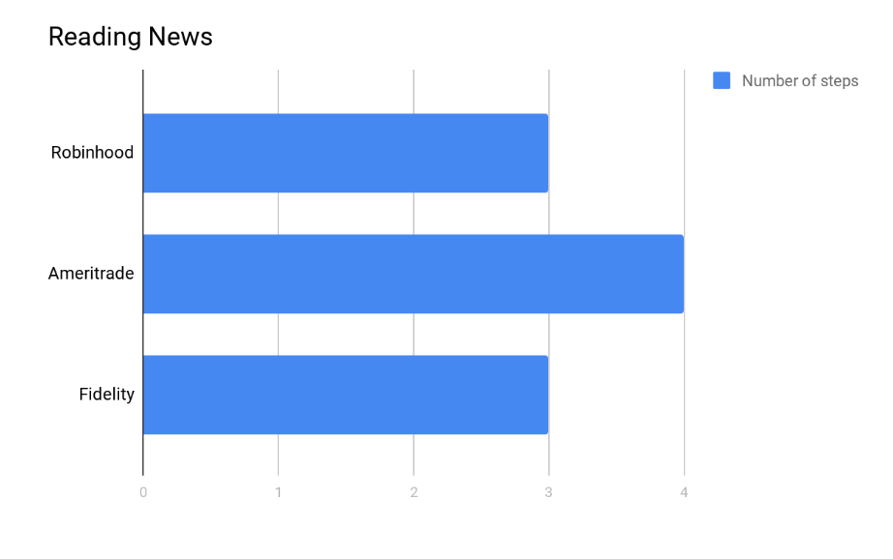
Task Flows
Maintaining stock watchlist
Reading Stock related news

Slide 14
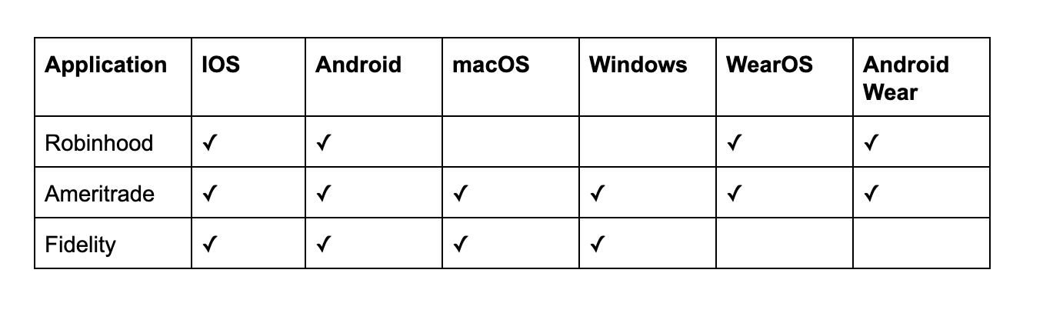
Availability
For this comparison, we will be comparing the platforms that the particular application is available in

Slide 15
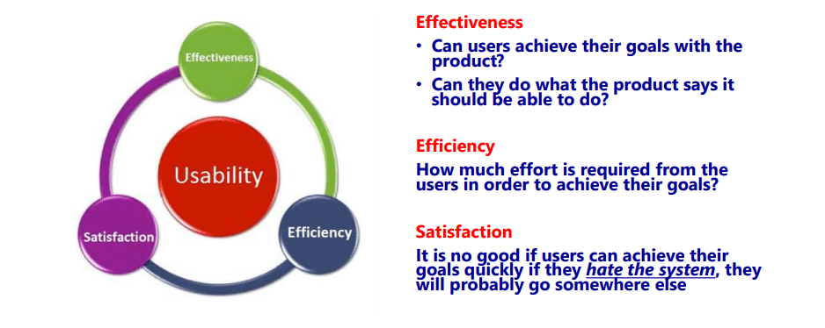
Usability Metrics
The metrics used to measure usability for the purpose of our evaluation is
Easy to use
Easy to learn
Visually Appealing

Slide 16
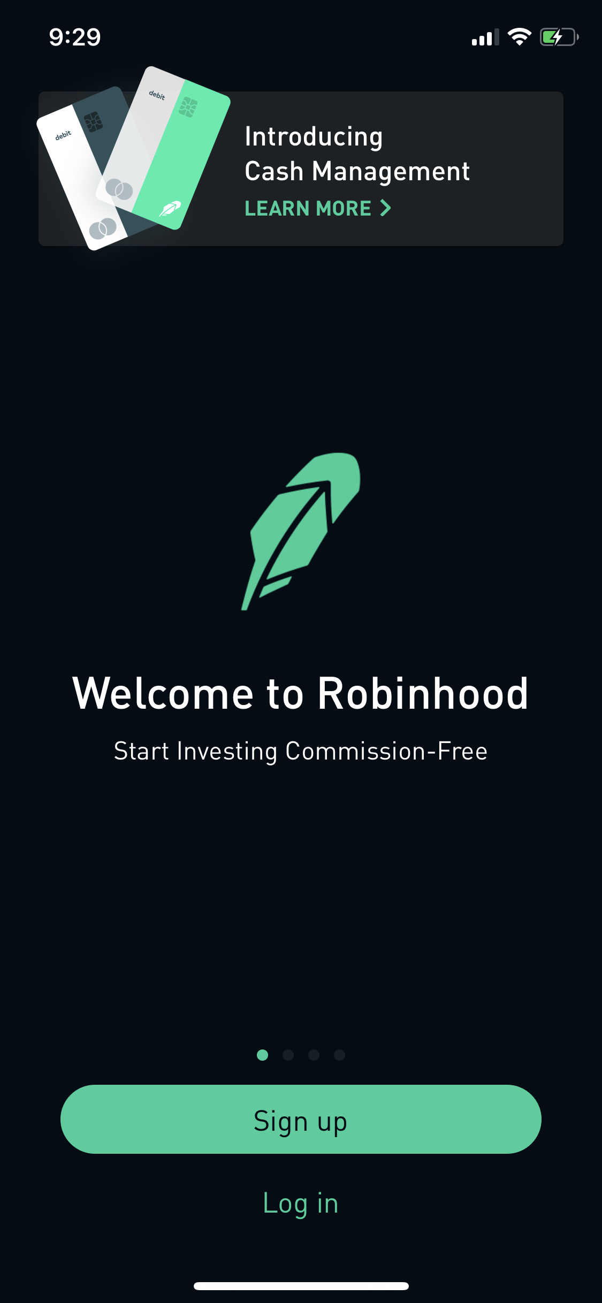
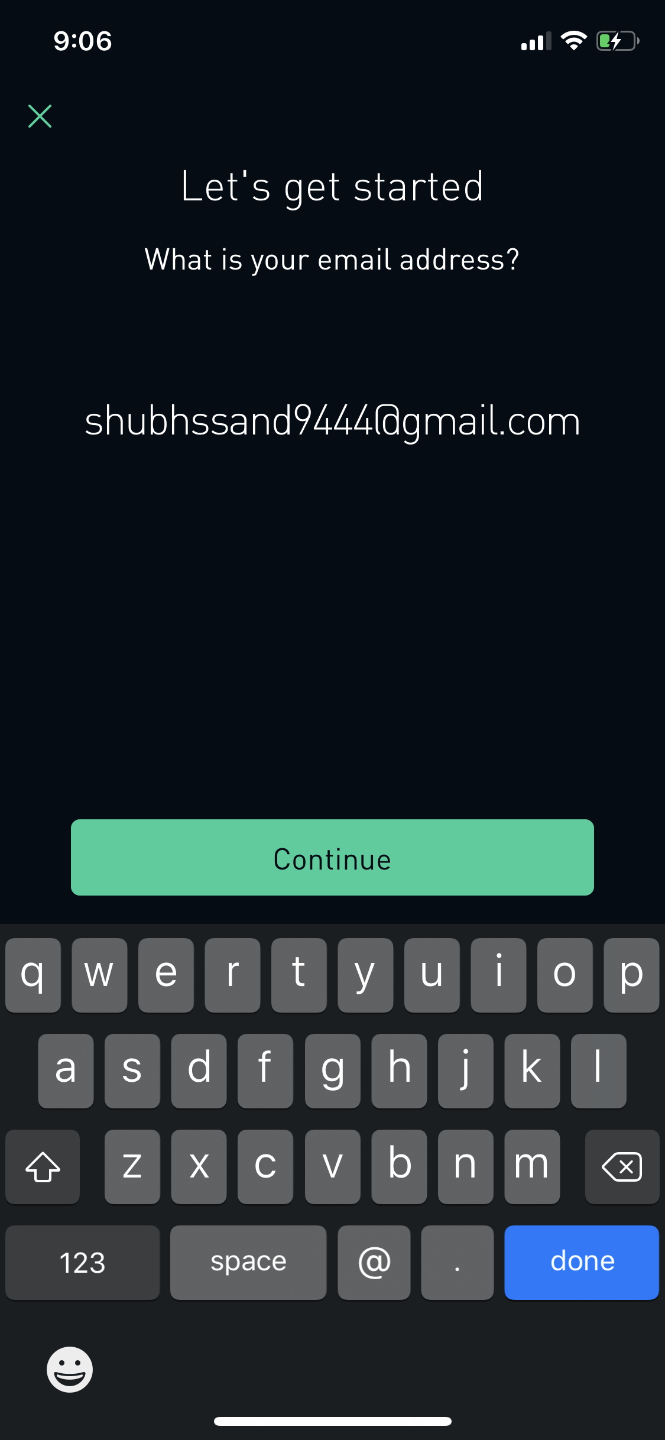
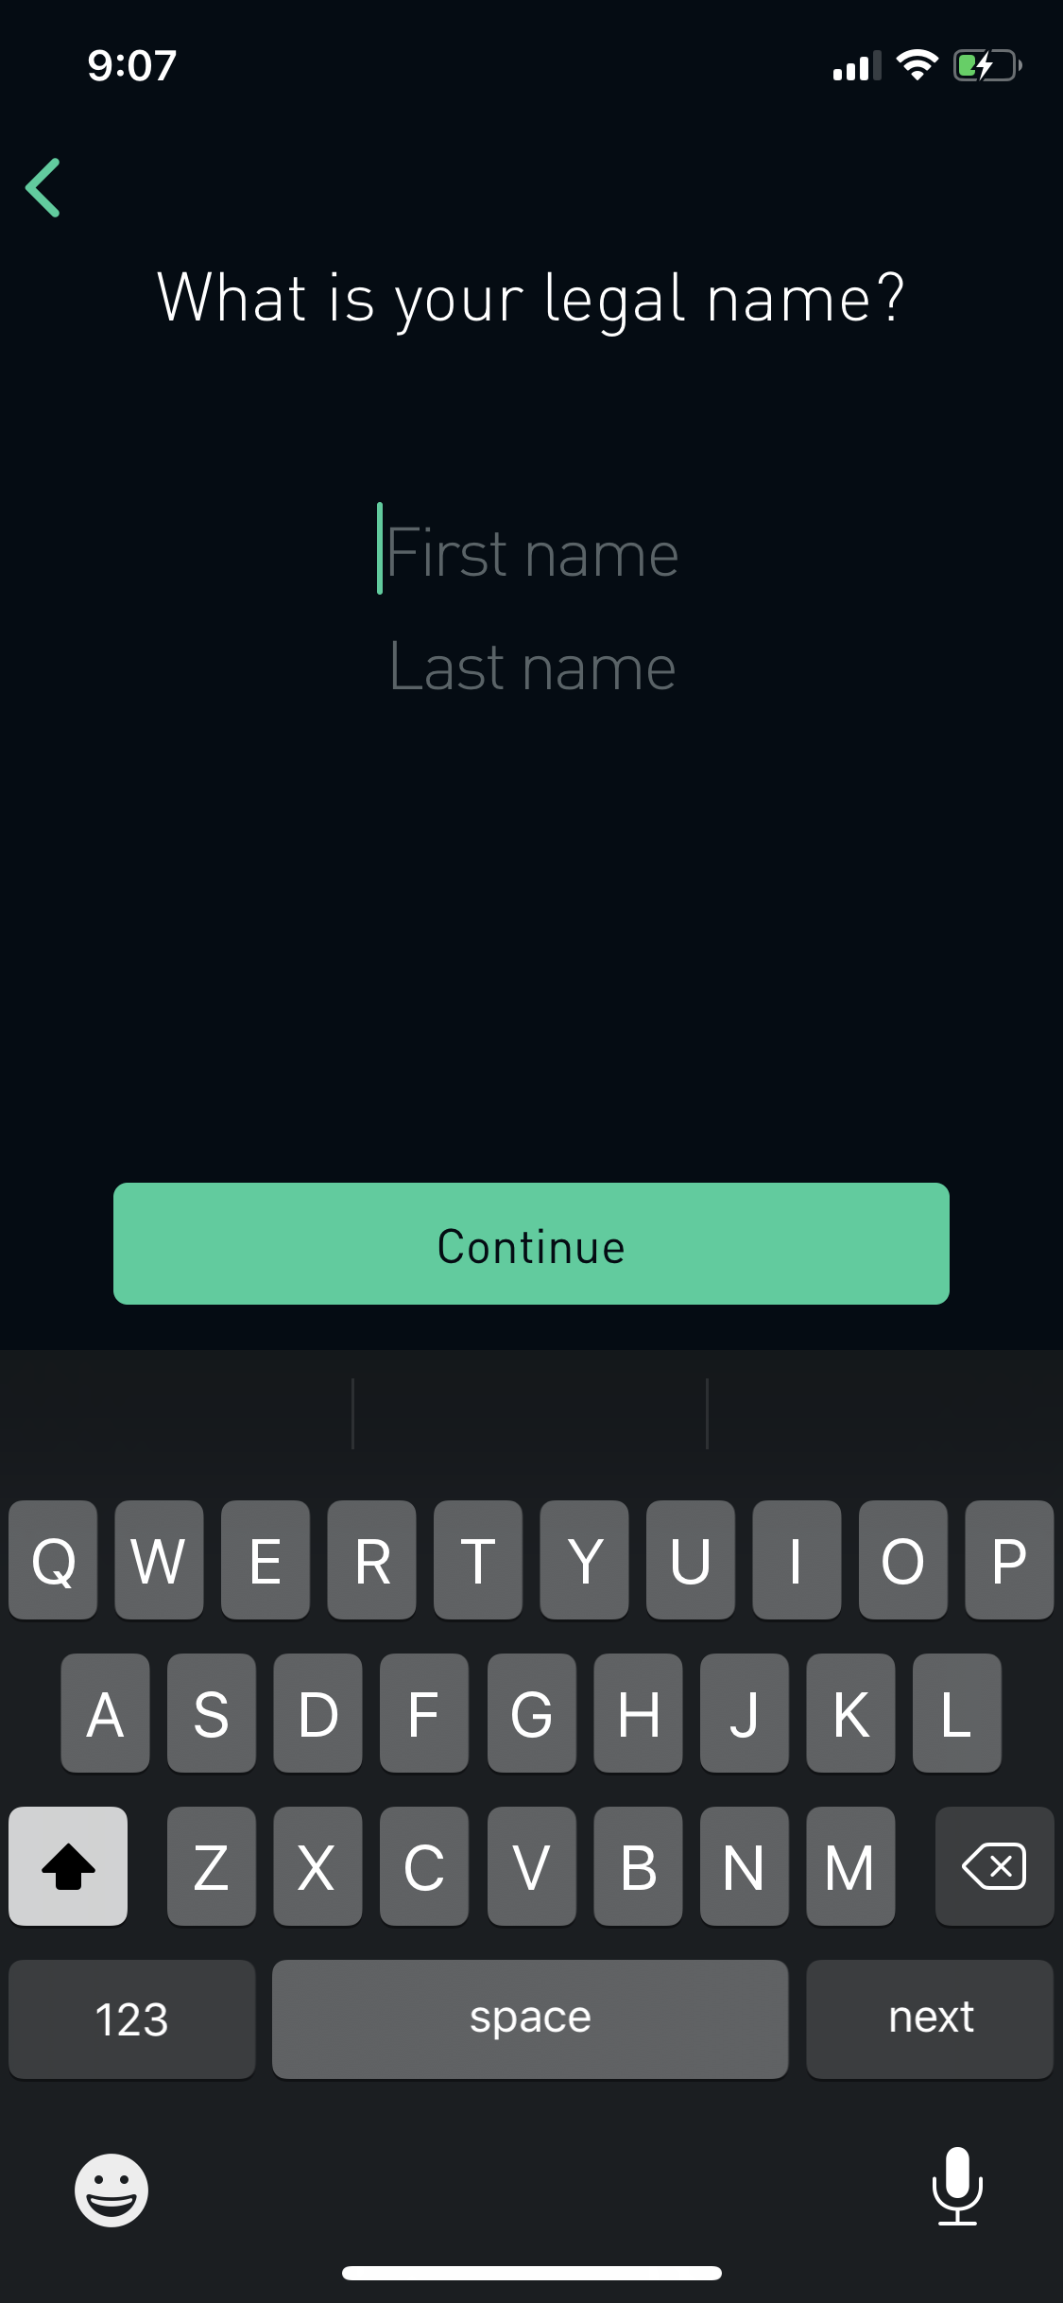
Task Evaluation
Task : Sign up to Robinhood app as a new customer
The signup button is designed according to the Fitts law as the button is larger in size and also an easy target to hit for the user.
The sign-up task is a progressive process where on each screen the user is asked a specific information.
Progression feedback such as a percentage or milestone bar will help the user to identify the task progress effectively.

Slide 17
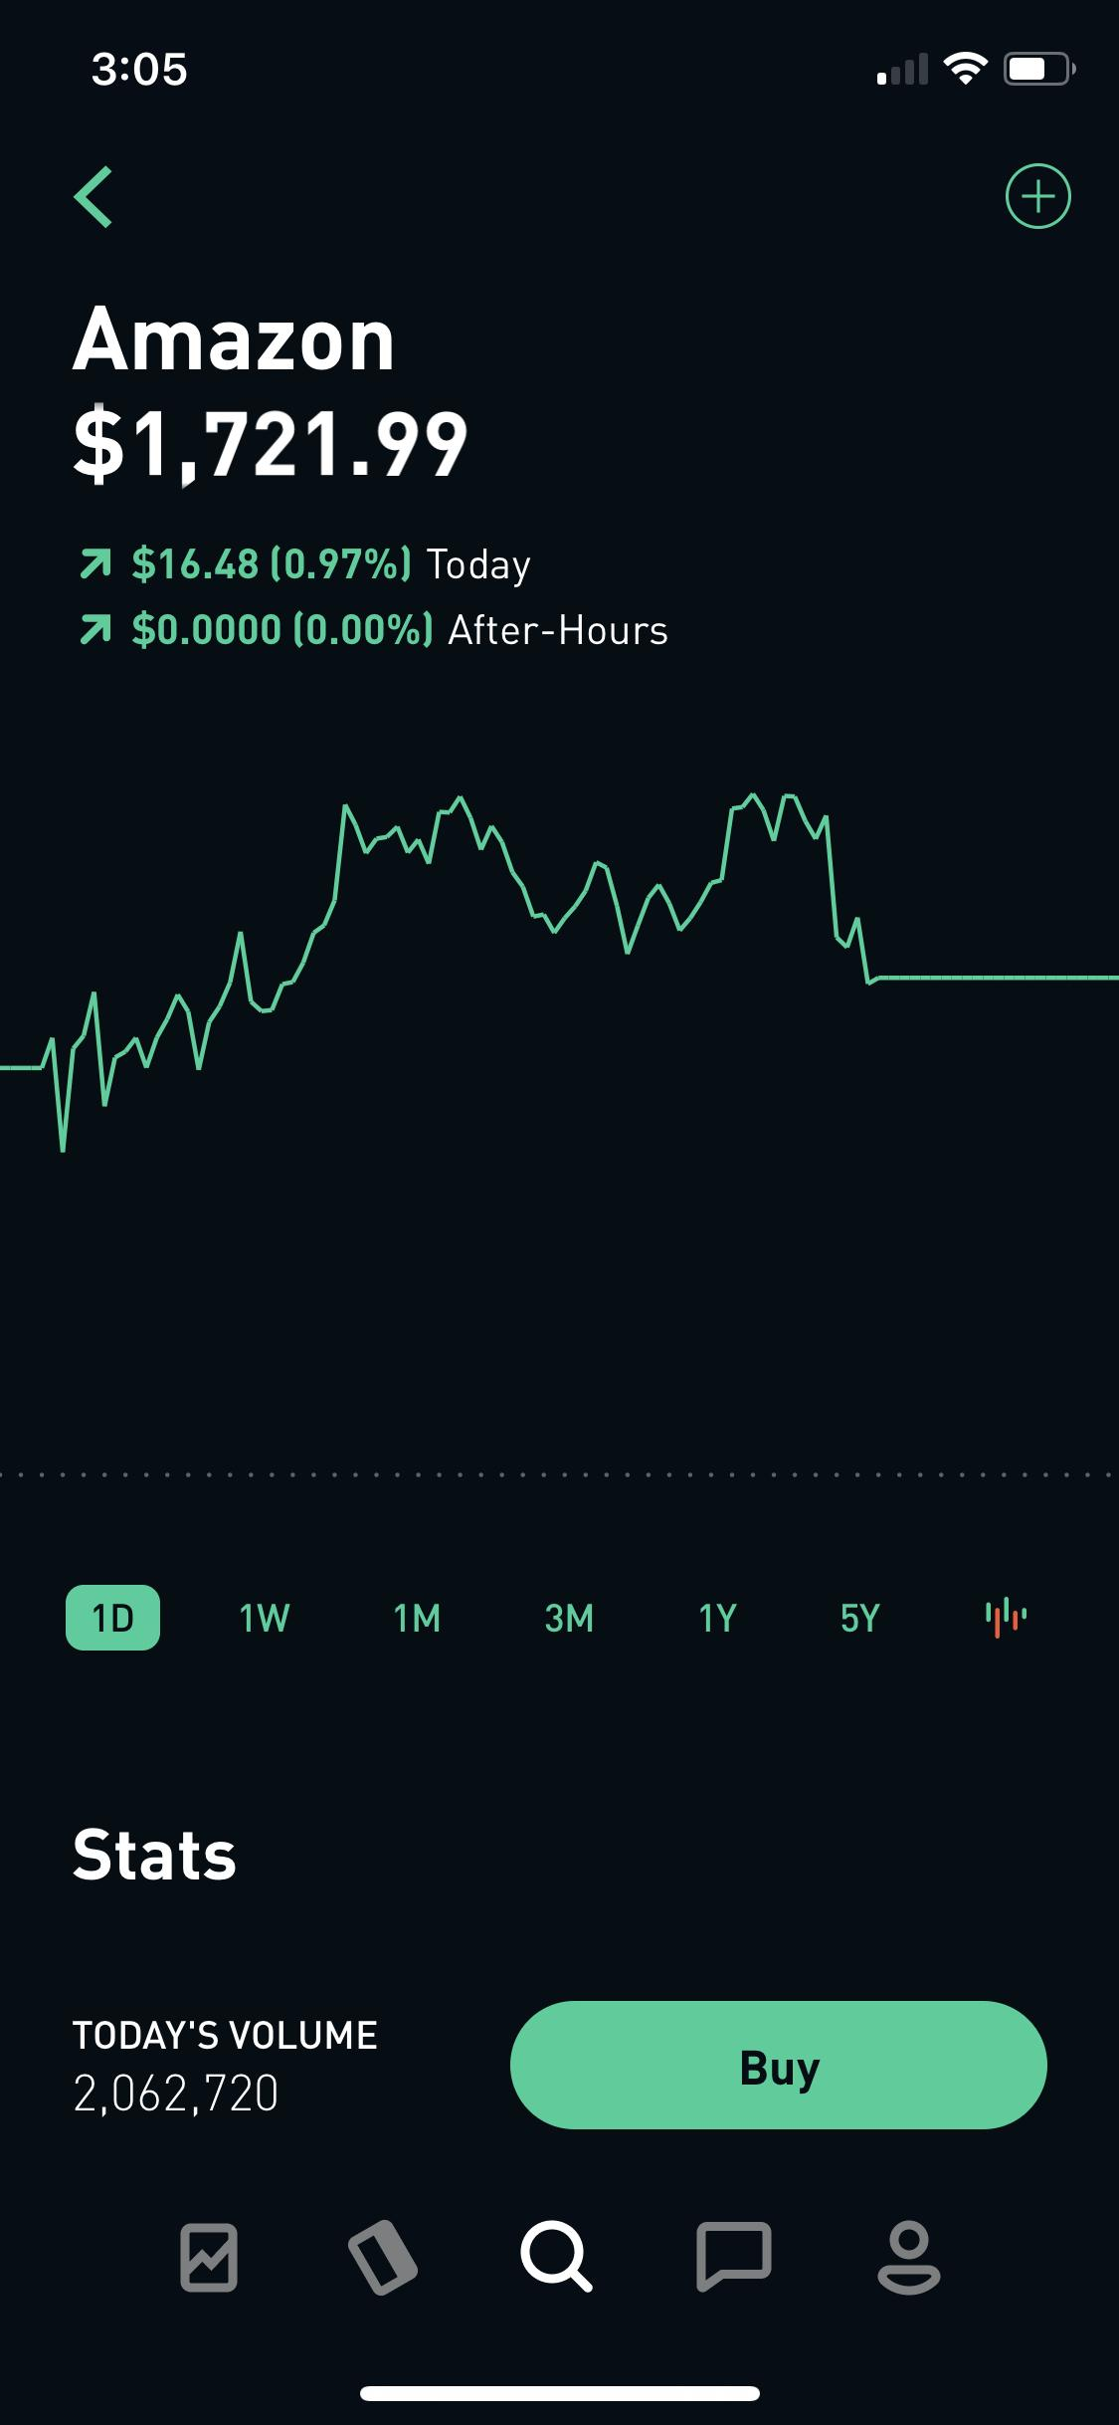
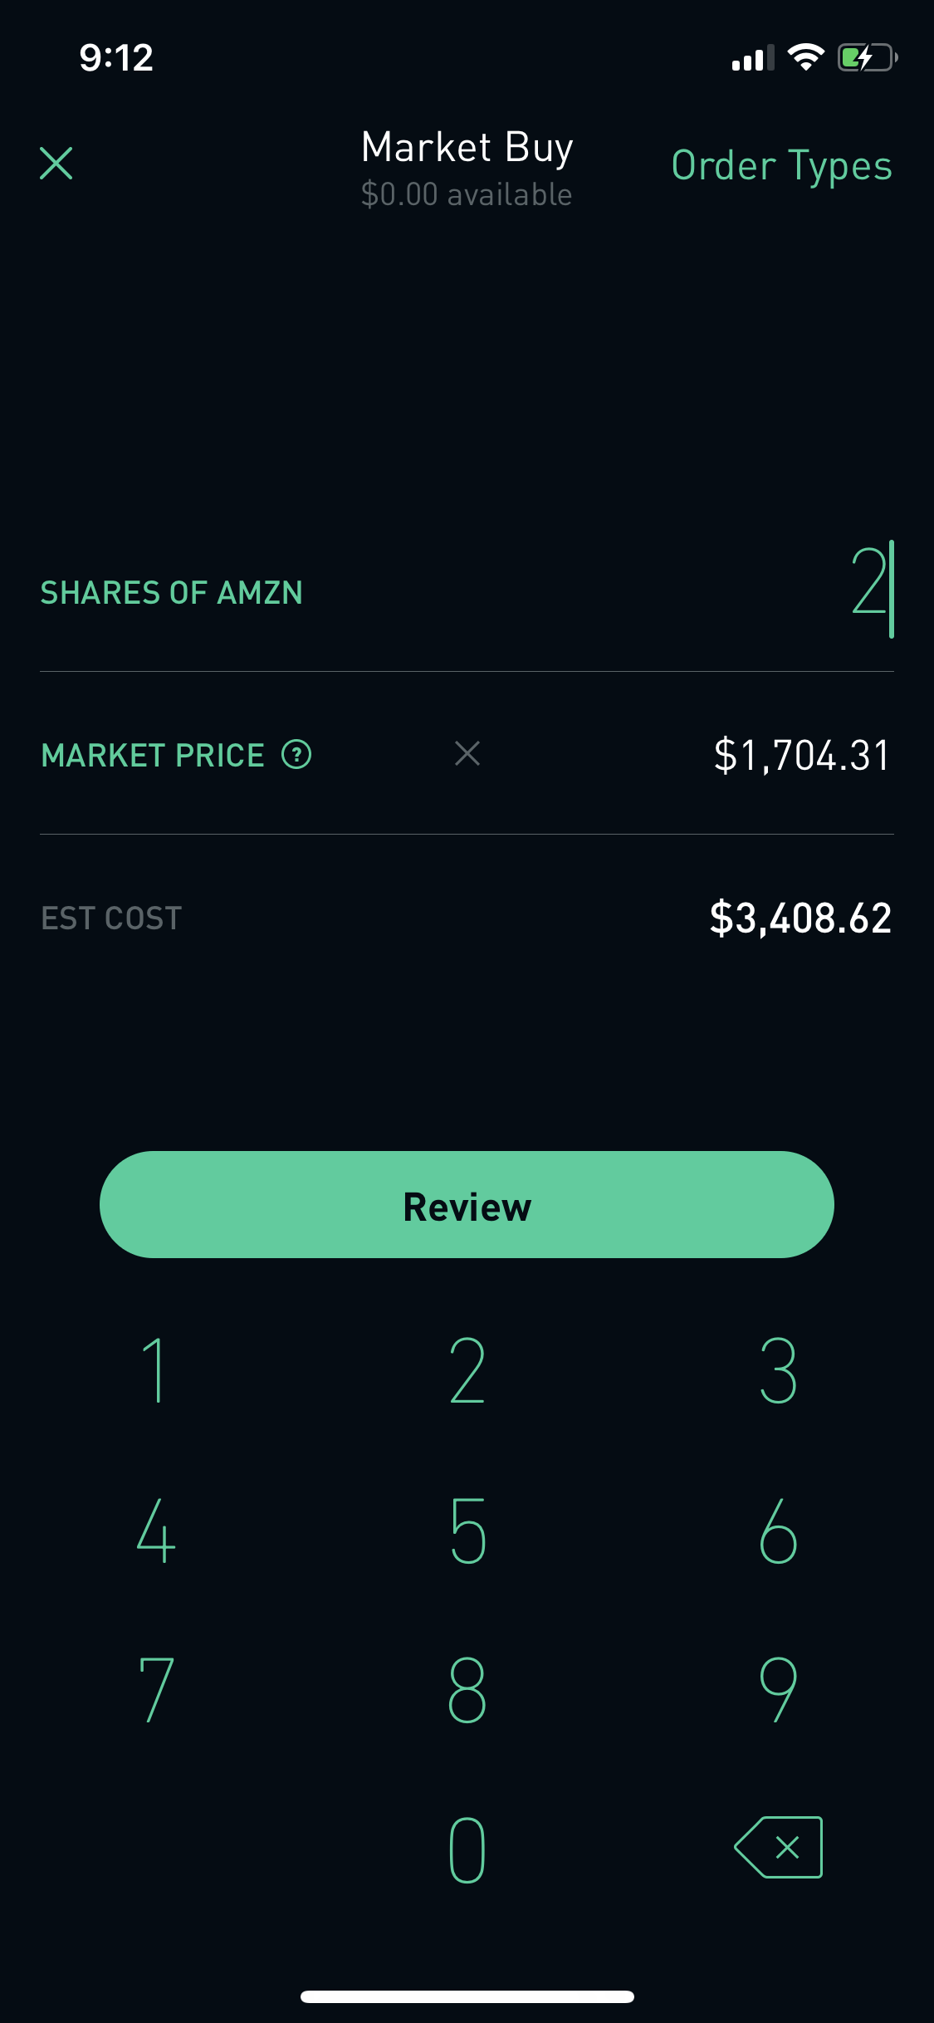
Task Evaluation
Task : Buying a stock on Robinhood app
Autosuggestions for stock/cryptocurrency search
Graphically and visually appealing charts and statistics
The “red” button color - when price of stock has been down
On the buying page we have affordances in different order types
Mapping in two scenarios :
a) Continuous updates to the stock price b) On selecting stock quantity the multiplier updates the final amount.

Slide 18
Tools and Techniques
Usability Task Analysis:
- User intends to search for the stock price on a particular day or time
- User wants to get his/her portfolio details
Smartphone Timer | To note task completion time
Qualtrics survey | To gather multi persona perspectives
Draw.io | To model task in flow charts
Microsoft excel | To aggregate the data
Screen recorder | Note usability and user experience
Notes:
Additional Studies

Slide 19
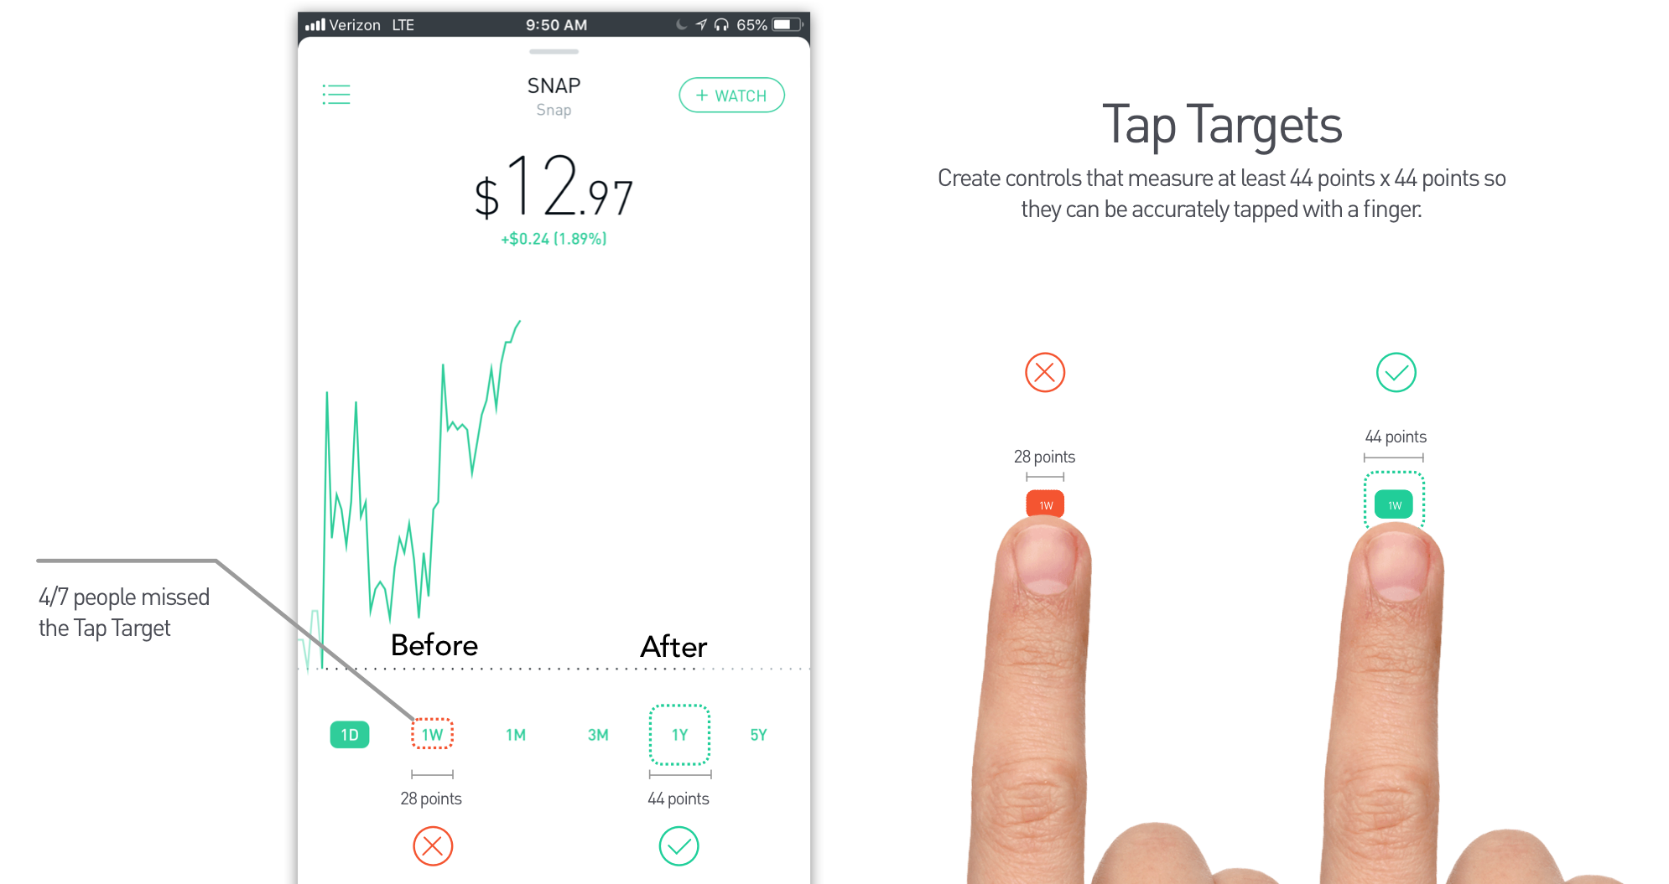
Suggested Enhancements
Soften cognitive impetus on the user:
- Revealing additional information when requested but the user.
Make time frame selection buttons larger(Fitts law):
- The size of interactive elements should be well thought of and there should be consideration of people with visual impairments a shown in the fig below.
Provide a search tool for studying historic prices of the stock:
- Currently the user has to search swipe through the entire line graph
- As a solution, a search box should be provided for fostering fine grained search
Notes:
Additional Studies

Slide 20
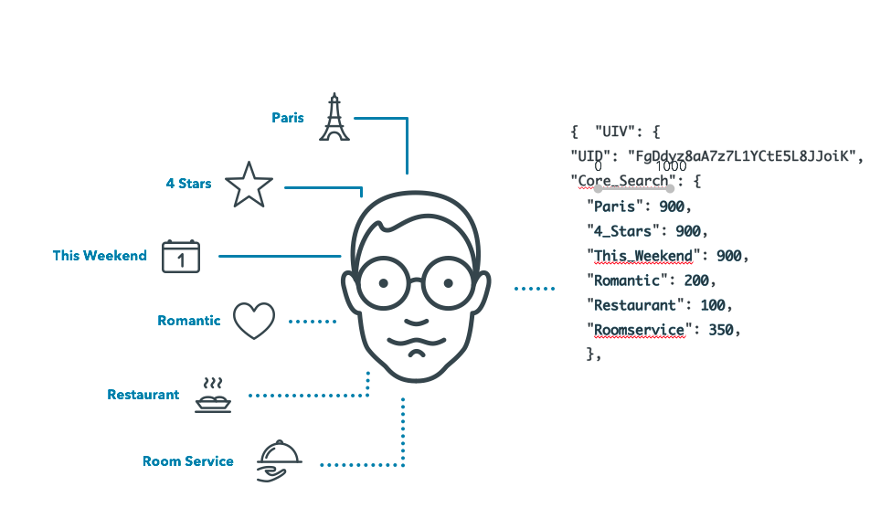
User Profiling
User Profiling can be defined as the process of identifying the data about a user interest domain
Target age group 30 (Since 78% of the users are between the age of 28 -35)
Most of the users are university
students
Personas:
Created Based on :
Content present in the profiles
Survey

Slide 21



Buying the stocks frequently with price of less than 10$ Selling the stocks for profit as soon as there is an increase in the stock value Save the companies to the watchlist to make a decision | Buy and sell stocks at a certain price in the future Watch news in the app to know the current information Read the announcements to know the changes in the app | Buying the stocks of companies with good price history Wait till there is a huge increase in the price of the stock Buy the stock at the market price

Slide 22
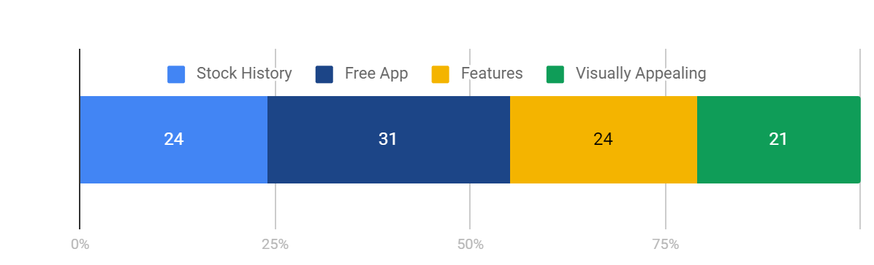
Usability Evaluation based on your Usability Metrics - Survey
Q1) What do you like the most about Robinhood?
Q2) What do you dislike the most about Robinhood?
Q3) Rate on scale on 1 to 10 Robinhood’s ease of selling and buying the stocks
Q4) Rate on scale on 1 to 10 Robinhood’s user friendly design
Q5) Rate on scale on 1 to 10 Robinhood’s visually appealing

Slide 23
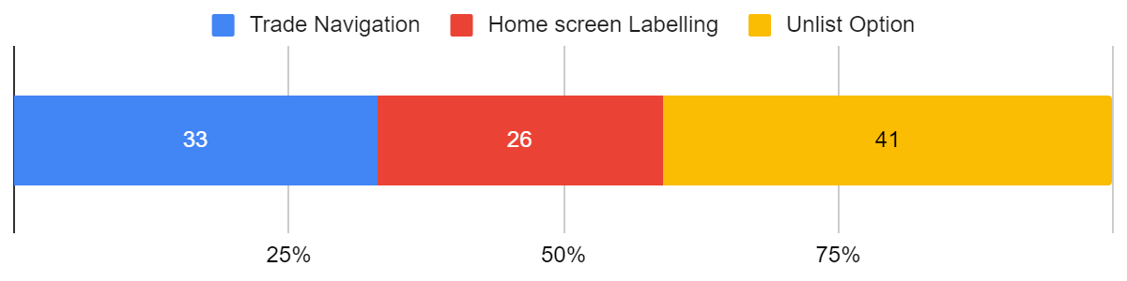
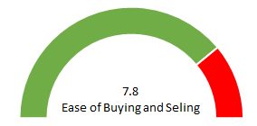
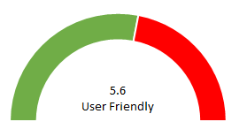
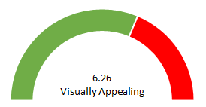
Q2, Q3, Q4, and Q5 Survey Results

Slide 24
Usability Evaluation based on your Usability Metrics - User Study
Task 1: Select a Company, buy its stocks
Is this task easy to learn how to do?
8 ✅, 2 ❌
Is this easy to use?
All took - 40- 42 seconds and it takes 4 steps (only one was able to do)
Task 2: Add the companies in watchlist
Is this task easy to learn how to do?
9 ✅, 1 ❌
Is this easy to use?
All took 30 seconds and it takes 3 steps (only one person took 5 steps)

Slide 25
User Study
Task 3: Browse for a company
Is this task easy to learn how to do?
10 ✅, 0 ❌
Is this easy to use?
All took 30 seconds and it takes 3 steps
Easy to Learn
Easy to Use

Slide 26
Conclusion
Robinhood excels in:
Seamless multi platform user experience.
Grouping and consistency of information.
Mapping of user inputs to changes in the screen
Affordances and personalization
Improvements:
Smaller tap targets
Information for the labels as feedback
Incomplete portfolio information on the app versus on the desktop version
Revealing additional information only when requested by user

Slide 27
Thank You
Team PHOENIX

